Slide 1

IBot
Network Communication Service
Adilkhan Altynbek

Slide 2
Design Prompt
Overview
School: Purdue University, West Lafayette, IN, USA
“Your school wants to strengthen the community by encouraging experienced students to connect with new students and help them adjust to campus life. Design an experience that allows mentors and mentees to discover each other. Consider the needs of both mentors and mentees, including how someone may become a mentor and how to connect mentors to mentees.”
Problem
Research
Design
Evaluation

Slide 3
Problem Framing
The school wants to strengthen the campus community and help out new students by encouraging more experienced students to help them out. Why?
Adjusting to campus life can be a challenging experience for any student and especially for international students. Purdue University has one of the biggest international student populations in the country. Many resources (e.g., orientation weeks) already exist to smoothen the experience for new students. However, these resources are either run over a short period of time or students choose to ignore or under use them for various reasons (e.g., anxiety, lack of motivation, and so on).
Thus, the school wants to provide support to new students through other, more natural means, such as connecting them with more experienced students in a mentor-mentee sort of relationship.
The question is then, how should such connections be fostered?
Problem
Framing

Slide 4
Problem Framing
The problem then essentially boils down to two main concerns:
If new students choose to not use the available resources, how do we motivate them to connect with their more experienced peers?
As there are no obvious benefits of mentoring a new student, how do we encourage and promote mentorship idea to the experienced students?
To investigate these further, I have conducted some research in the forms of brainstorming session, competitive analysis, and user research.
Problem
Framing

Slide 5
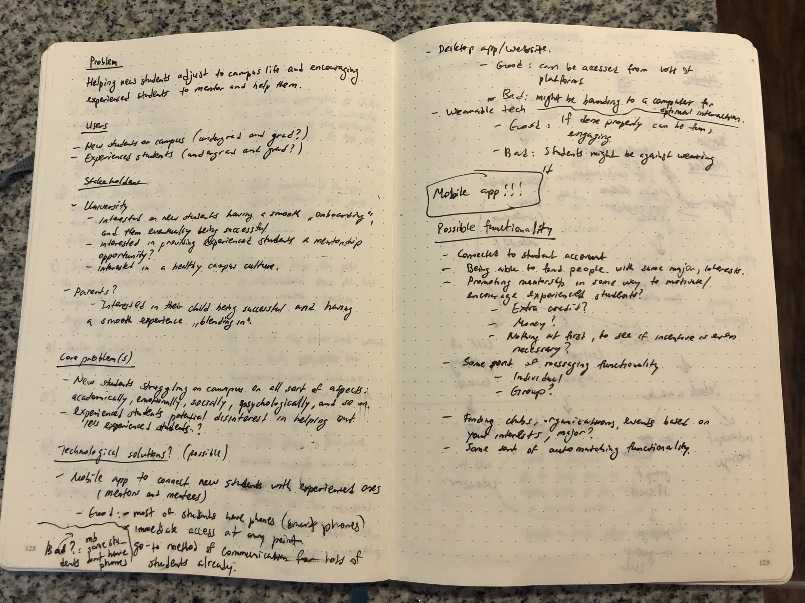
Brainstorming
Research
Brainstorming

Slide 6
Competitive Analysis
Within the Purdue University, besides the “orientation week” type of events, many established mentorship or mentorship-like programs exist:
Supplemental Instruction (SI) sessions, where upperclassmen help new students with coursework for common freshman courses
BoilerMENTOR program which provides peer-to-peer mentorship for freshman that are recipients of Emerging Leader Scholarship
Mentorship programs within the individual university departments (e.g., Mechanical Engineering, Animal Sciences, Life Sciences, School of Management, and so on)
Mentorship programs within other specialized university departments (e.g., Honors College, Disability Resource Center, Non-traditional students, and so on)
While all these resources are clearly valuable to students, no personal, private, general, and on-demand mentorship service exists on Purdue’s campus.
Research
Brainstorming
Competitive Analysis

Slide 7
User Research
10
interviews
10-15 min
=
+
4
“mentees”
2 years or less in their current degree
6
“mentors”
3 years or more in their current degree
Research
Brainstorming
Competitive Analysis
User Research
Interviews

Slide 8
User Research
For “mentees”, I mainly asked about what kind of difficulties did they face as a relatively new student on campus, how did they solve them, what kind of resources do they use, and so on.
For “mentors”, I mainly asked about their perception of the idea of mentorship, whether they have any mentorship experience, how did those sort of relationships work out for them in the past, and so on.
Research
Brainstorming
Competitive Analysis
User Research
Interviews

Slide 9
User Research
Main themes that emerged from the “mentee” interviews were:
New students often face issues with time management and also having to live alone and take care of themselves
School resources are not easy to find and often require in-person meeting, which some feel anxious about or feel that they don’t have time for that
New students use university-provided resources (e.g., professors, teaching assistants, advisors, etc) for academic support and use friends/peers for emotional/social/psychological type of support
Research
Brainstorming
Competitive Analysis
User Research
Interviews

Slide 10
User Research
Main themes that emerged from the “mentor” interviews were:
No formal mentorship experience, however plenty of mentorship-like experience (e.g., giving advice or helping out less experienced students)
Interaction often happens naturally rather than formally (e.g., in a student club setting, doing some sort of activity based on common interests like playing video games together)
Less experienced students approach about not only academic-related questions (e.g., coursework), but also about other more personal matters (e.g, where to buy winter clothing, how to behave during career fairs, etc)
Concerns about time committment of being a “formal” mentor
Don’t mind being approached and providing help/advice, however do not actively seek students in need or enroll in official mentorship programs
Research
Brainstorming
Competitive Analysis
User Research
Interviews

Slide 11
User Research
Research
Brainstorming
Competitive Analysis
User Research
With the insights gathered from the interviews, I created two personas: Sachin (mentee) and Chloe (mentor)
Interviews
Personas

Slide 12
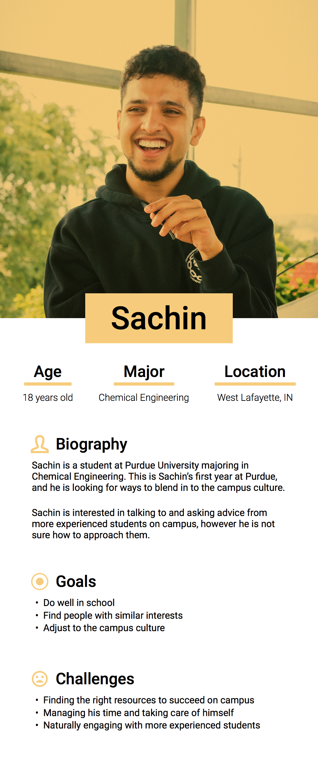
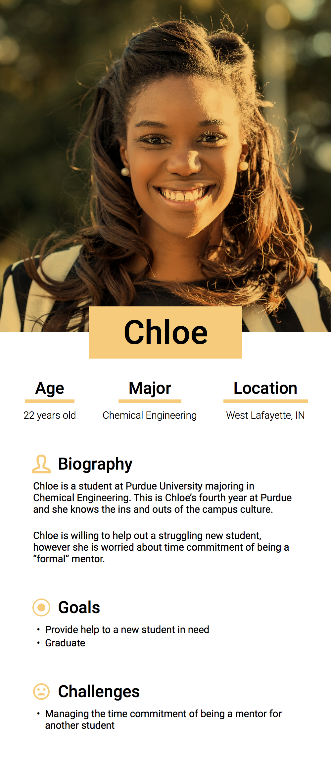
Personas
Research
Brainstorming
Competitive Analysis
User Research
Interviews
Personas

Slide 13
User Research
Research
Brainstorming
Competitive Analysis
User Research
Then to have an idea of potenial design requirements and the context in which the users can use the technology, I created a quick set of scenarios.
Interviews
Personas
Scenarios

Slide 14
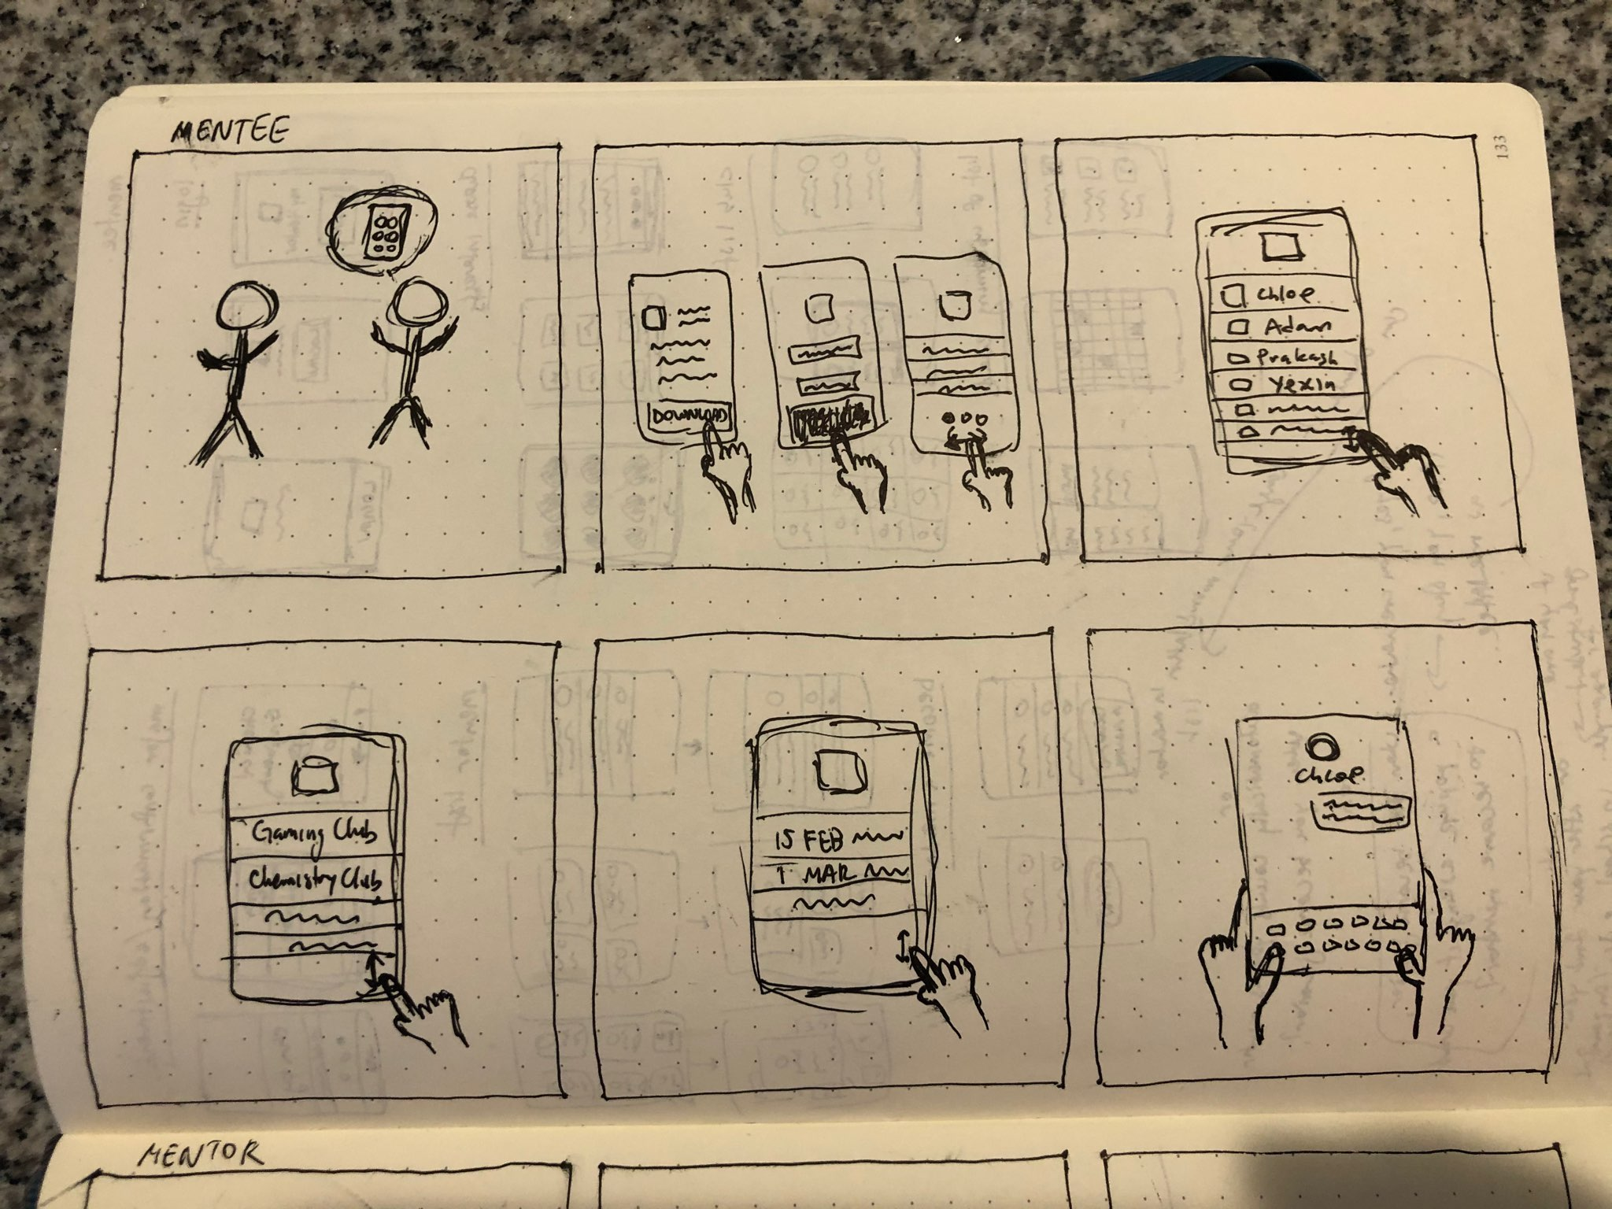
Sachin’s friend tells him about the app
He logins and fills his info
He checks out the mentors page
He checks out the clubs page
He checks out the upcoming events page
He messages one of the mentors
Research
Brainstorming
Competitive Analysis
User Research
Interviews
Personas
Scenarios

Slide 15
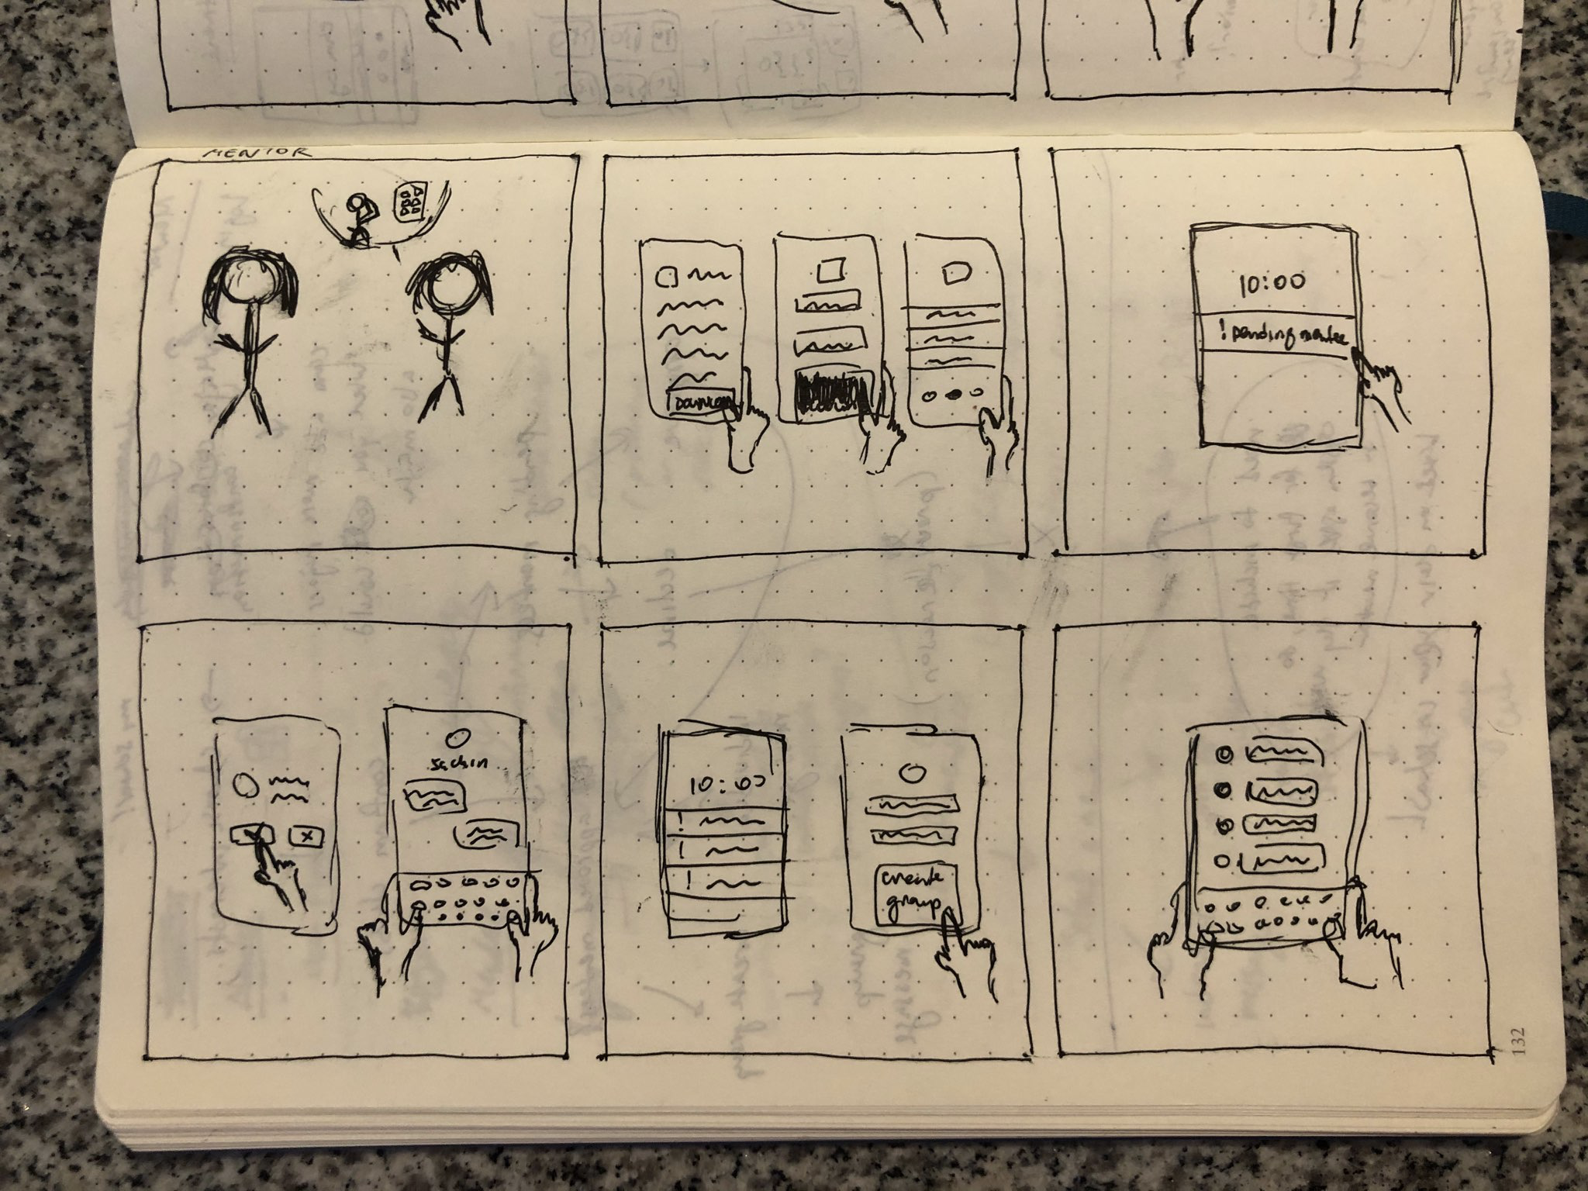
Chloe’s professor tells her about the app
She logins and fills her info
She receives a notification about a pending mentee application
She approves and messages her mentee
Chloe creates a group of her mentees
She messages her group
Research
Brainstorming
Competitive Analysis
User Research
Interviews
Personas
Scenarios

Slide 16
Insight
From the insights gathered from research, I modified the problem framing. Experienced students are eager to help and are not against the idea of mentorship. However, they worry about time committment and are not motivated to go out of their way to contact the struggling new students.
New students can feel anxious about having to meet in-person with their potential mentors and also worry about time committments of such meetings.
Based on these insights, I crafted a mission statement and a list of goals for how that will be achieved.
Research
Brainstorming
Competitive Analysis
User Research
Insight

Slide 17
Mission Statement
A digital experience that provides a welcoming, supportive, and nurturing environment for new students on university campuses

Slide 18
Goals
Help new students reach out to more experienced students based on their needs and goals
Help proactive experienced students find and help struggling new students
Allow students find more experienced students naturally, through student clubs and other initiatives

Slide 19
Design
Design
With a clear idea of the problem in mind, I moved to designing the UI so I could turn my research findings into visual elements.

Slide 20
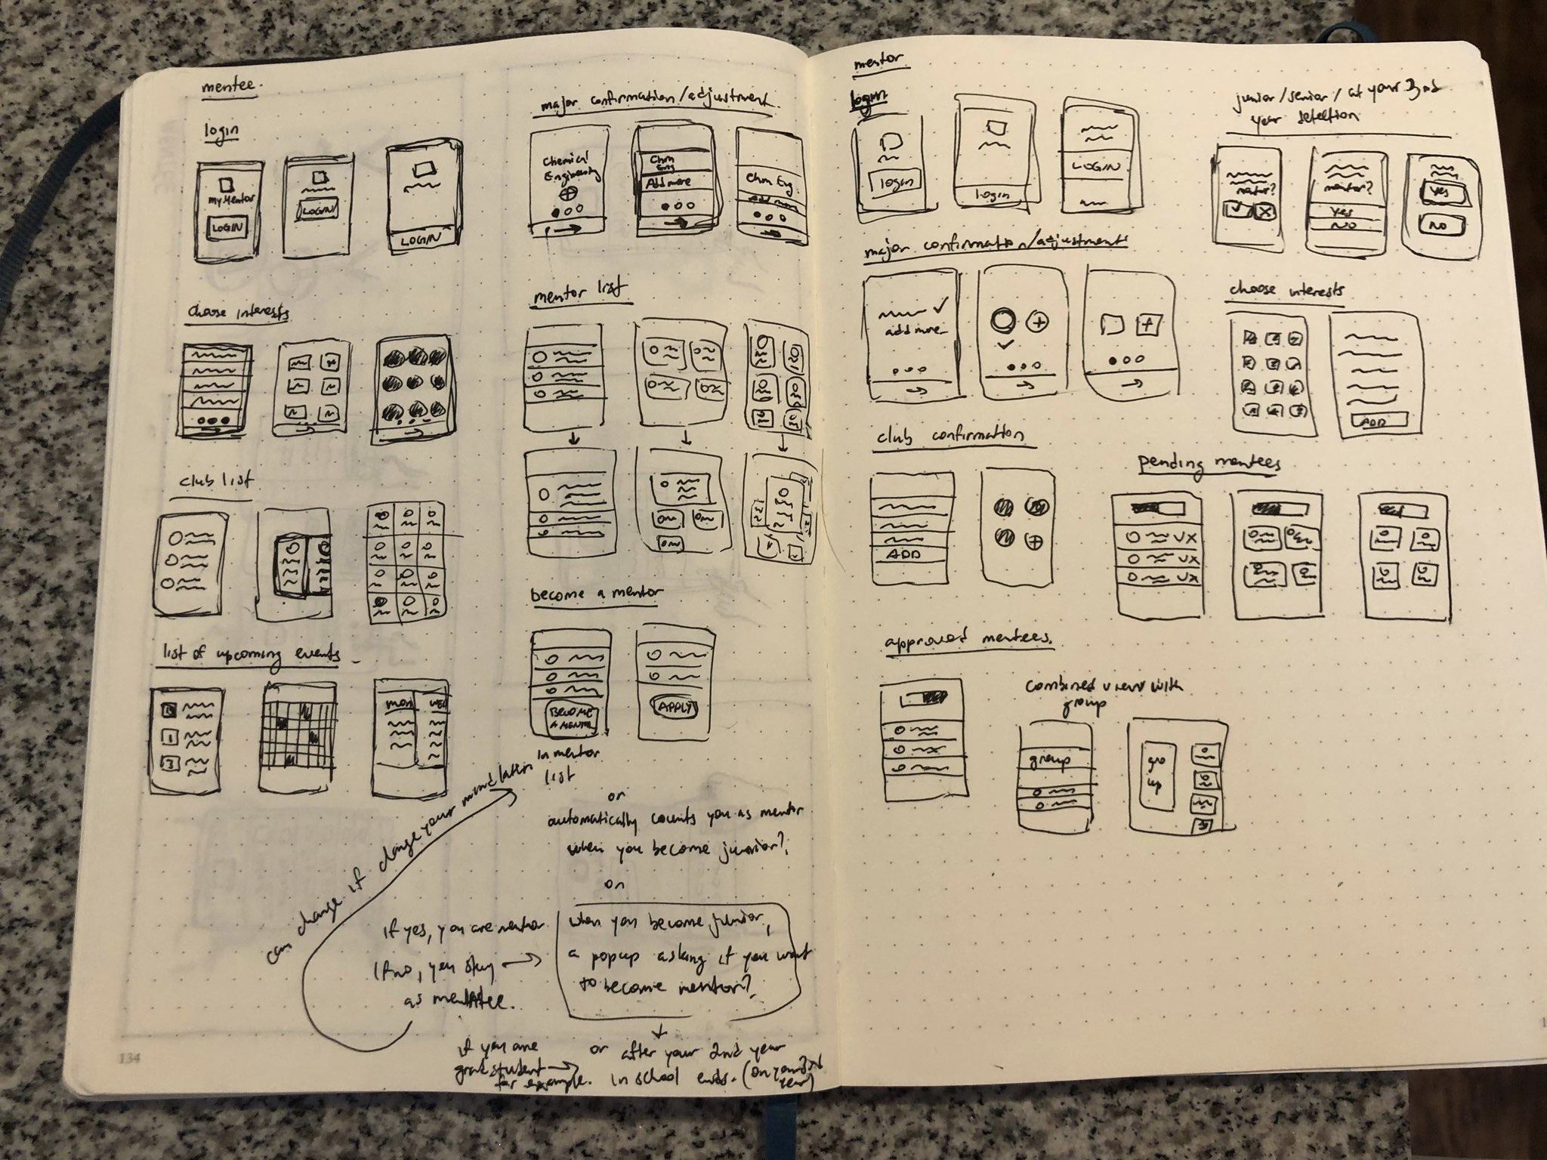
Sketches
I started with some rough sketches to map the functionality of the application and the rough placement of the elements.
Design
Sketches

Slide 21
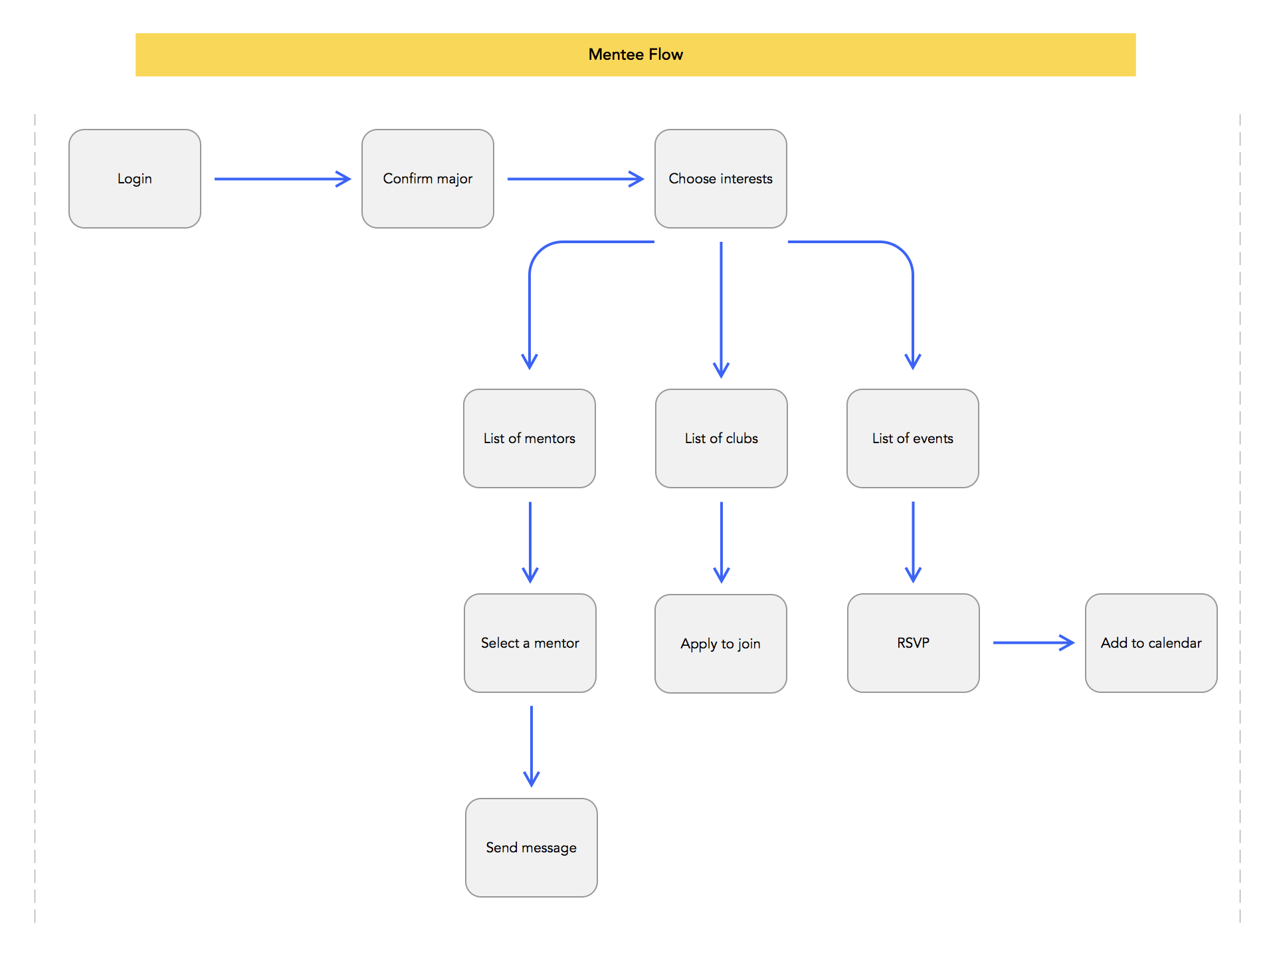
User Flow
Then, to map out how the users will interact with the app, I did some quick user flows for mentees and mentors.
Design
Sketches
User Flow

Slide 22
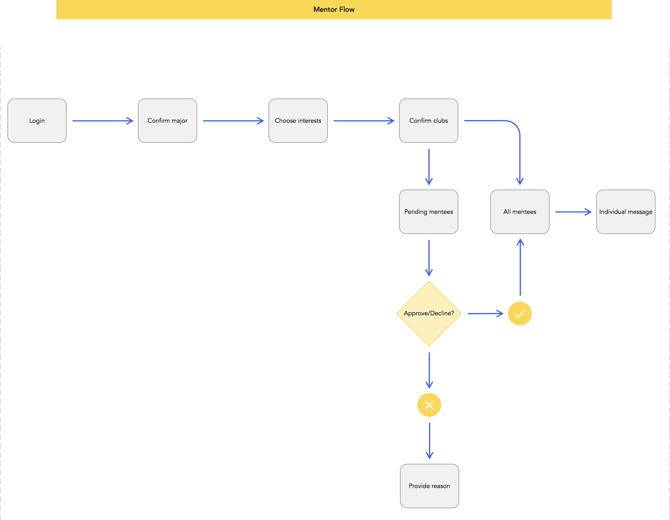
User Flow
Design
Sketches
User Flow

Slide 23
Wireframes
Design
Sketches
User Flow
Wireframes
With an idea of the functionality, elements placement, and the overall flow of the app, I went ahead and did wireframes in Sketch

Slide 24
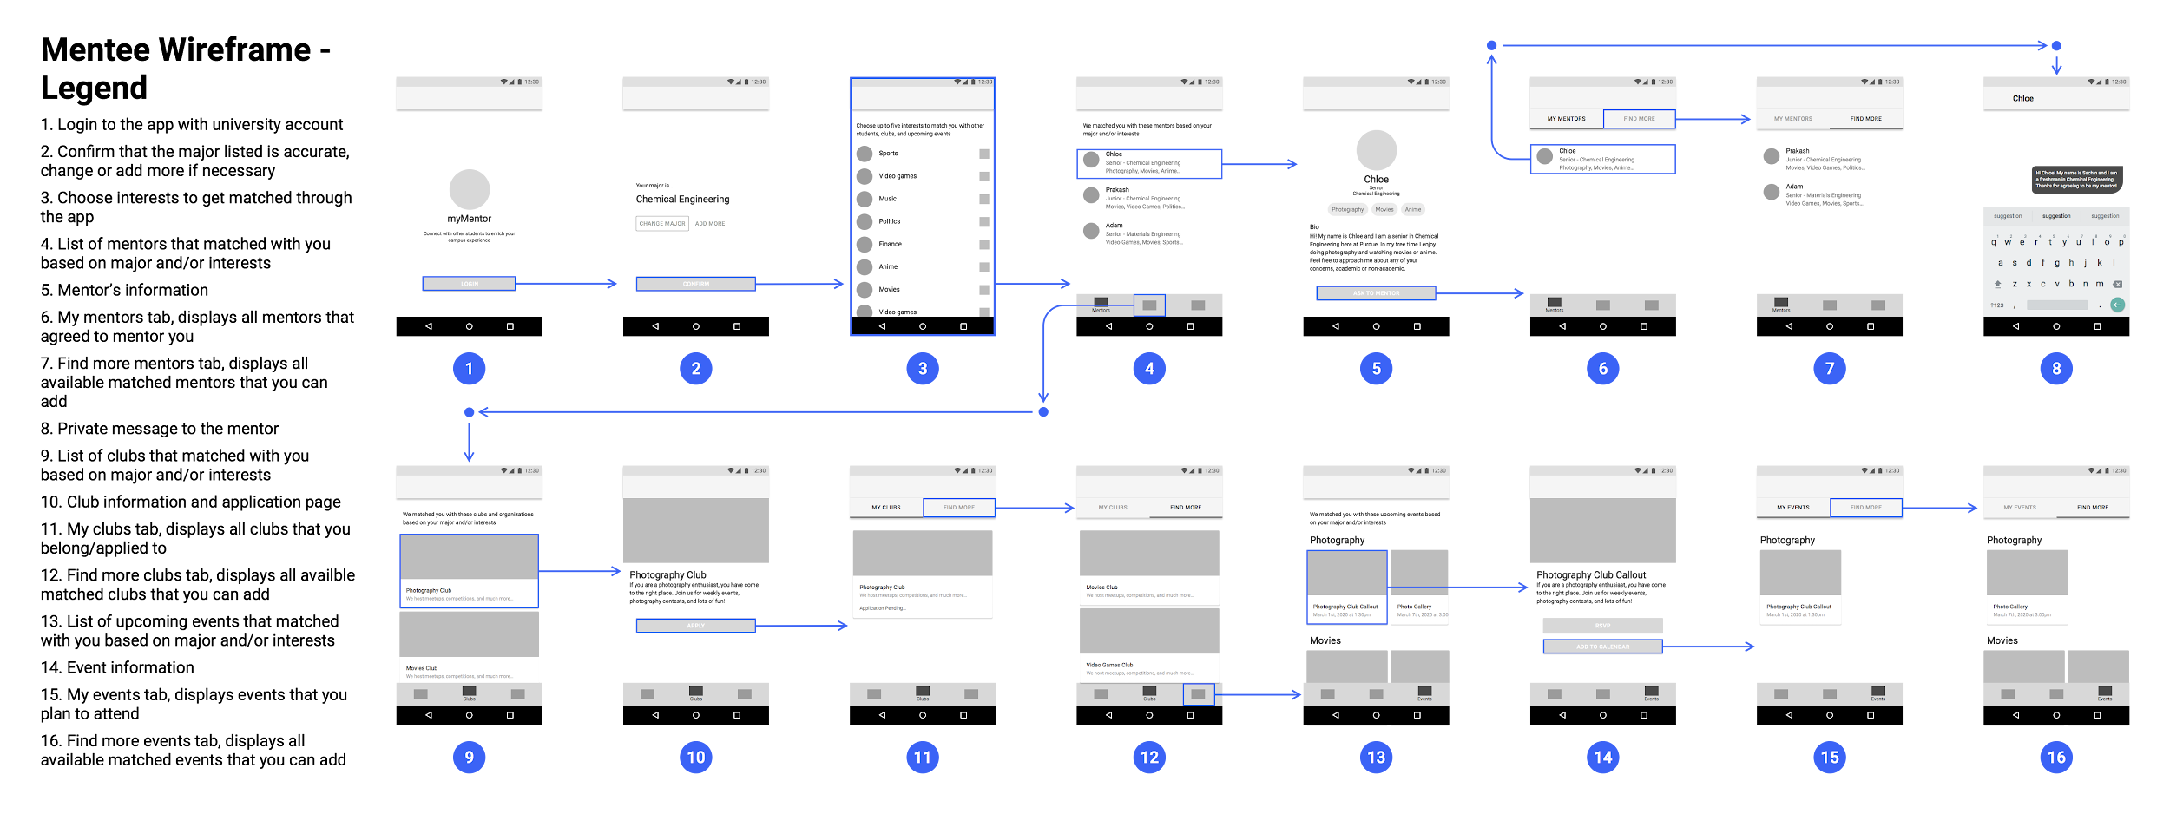

Slide 25
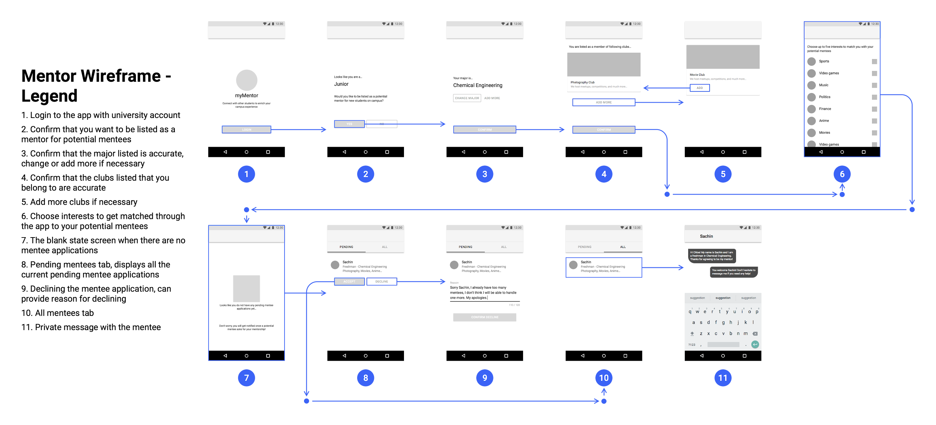

Slide 26
Final Design
Design
Sketches
User Flow
Wireframes
Final Design

Slide 27
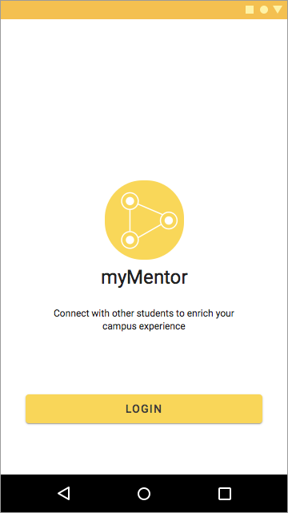
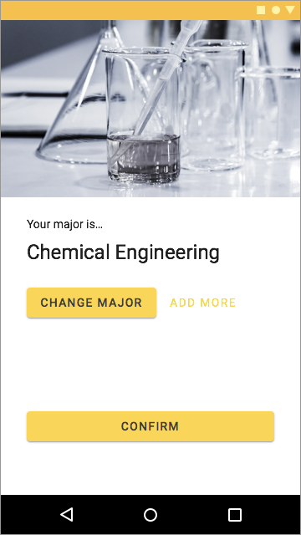
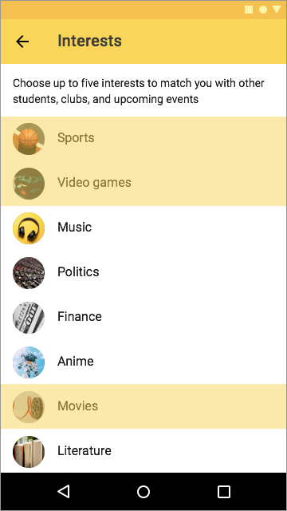
“Mentees” login with their university account. myMentor automatically detects their major and asks them to confirm it.
If the major is displayed incorrectly, students can change it manually. They can also add their minor or related majors.
As the last step of the application setup, students can choose their interests to help myMentor match them with right resources. By matching the mentees and mentors based on their interests and/or major, myMentor helps them connect more naturally.

Slide 28
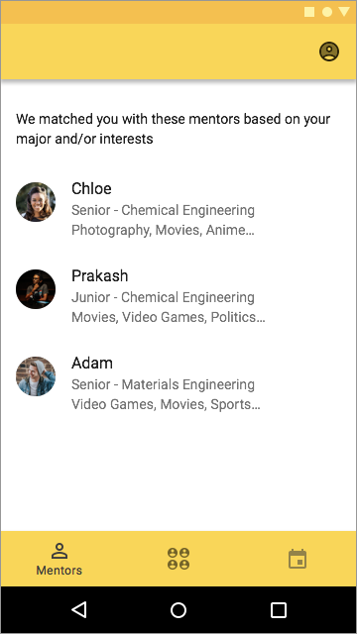
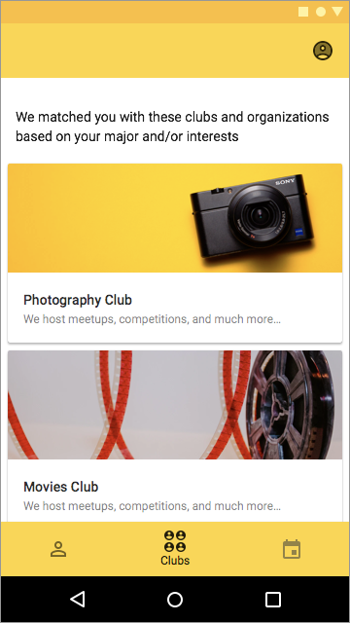
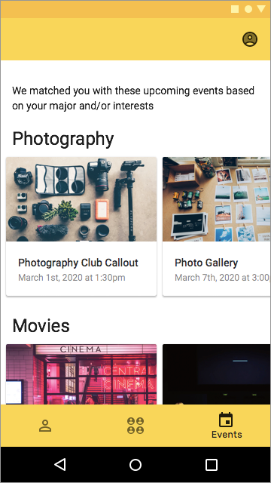
For “mentee” users, myMentor consists of three sections, that are presented in the bottom navigation:
Mentors
Student clubs
Upcoming events

Slide 29
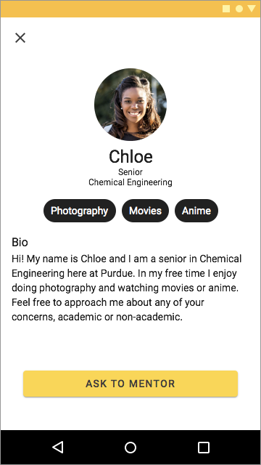
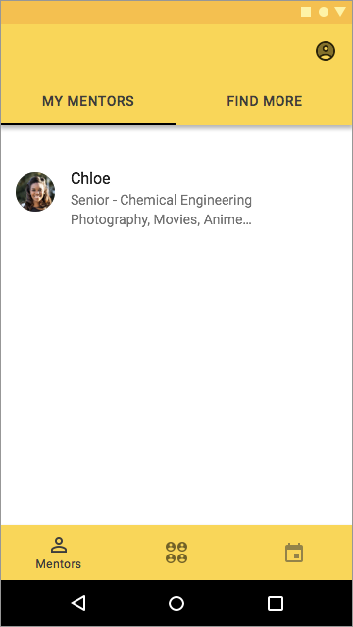
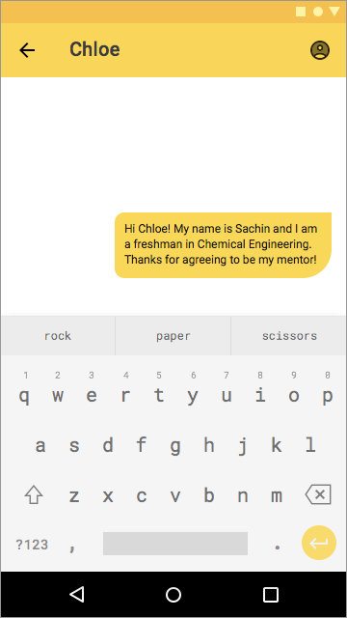
The mentors section displays all the matched mentors.
Students can read mentors’ information such as their major, year, interests, and a short bio.
Once approved by the mentor, the mentor and mentee can interact via private messaging, which solves the time committment concerns, as well as some of the anxiety issues of meeting in-person that new students might have.
Mentors

Slide 30
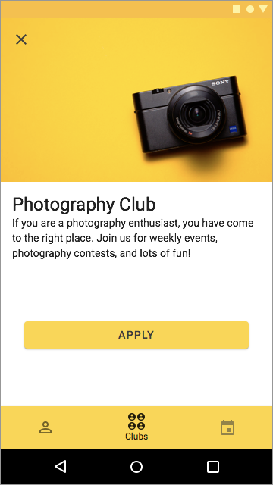
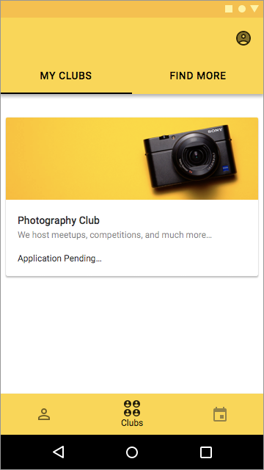
The student clubs section displays all the matched clubs that students can apply to join to.
Even though helping students find clubs was not in the design prompt, I decided to include this feature because it also allows students to connect more naturally.
Also, user research showed that most of the “mentors” interacted with their “mentees” through student clubs and organizations.
Mentors
Clubs

Slide 31
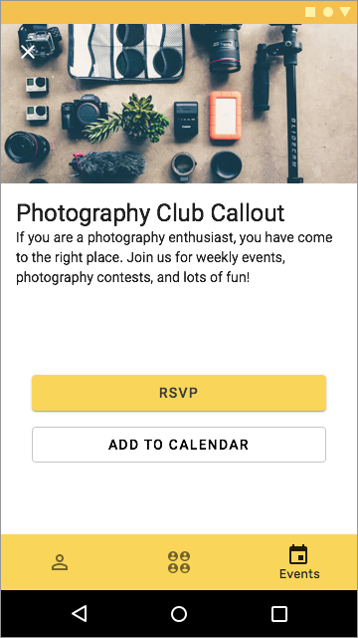
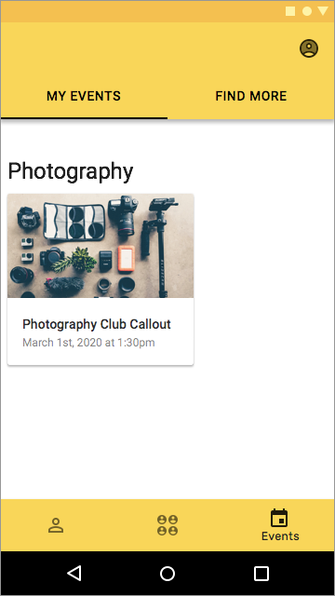
The upcoming events section displays all the matched events that students can RSVP or add to their calendar to not forget to attend.
Helping students find events similarly was not part of the design prompt, however I added it as a feature because it provides one more way of connecting naturally with other students.
Mentors
Clubs
Events

Slide 32
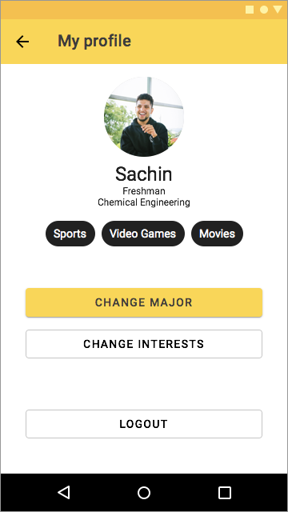
Finally, “mentees” can access their profile page by clicking the icon in the upper right corner in any page of the three sections.
In their profile page, students can change their major, interests, or logout from the application.

Slide 33

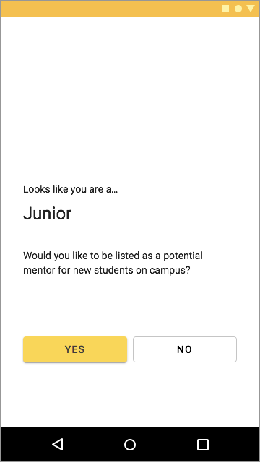
“Mentors” also login with their university account. The application also detects their major and asks them to confirm it.
The app automatically detects the year that the student is in and if the student is in their 3rd year or higher, it asks them if they want to be listed as a mentor.
Similar process applies to students who have been mentees before their 3rd year in college, where the app asks them if they want to be a mentor once they reach that stage.

Slide 34
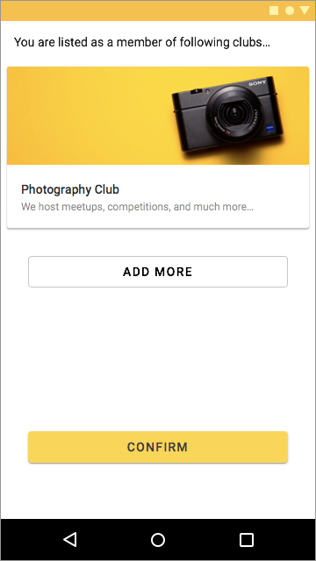
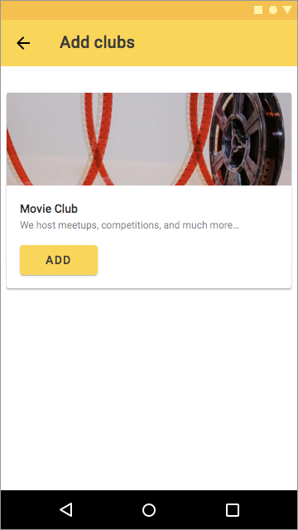
As more experienced students are more likely to be familiar with student clubs and belong to some already, the app does not match them with clubs.
For mentors, the app simply confirms the clubs that the student belongs to in order to use that information for matching with mentees.

Slide 35

Similar to mentees, mentors also choose their interests to help the app with matching.

Slide 36
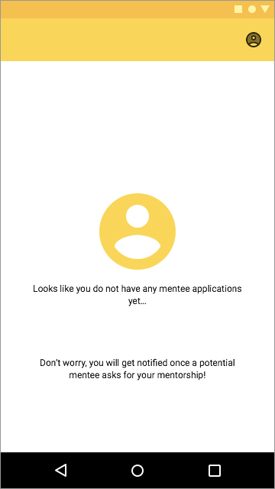
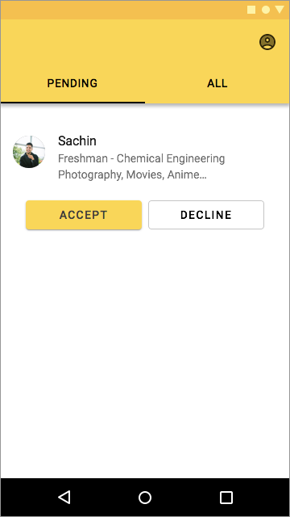
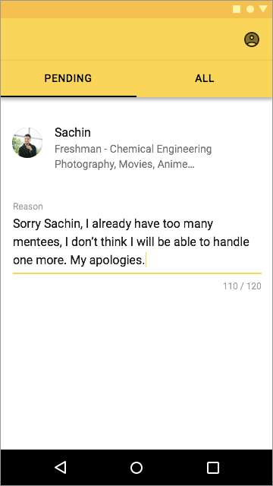
After the setup, the new mentor is automatically added to the mentor list. Once a mentee asks the student to mentor them, the app notifies the mentor.
The mentor can then approve or decline the application based on their availability.
If the mentor chooses to decline the application, they have to provide reasons for doing so.

Slide 37
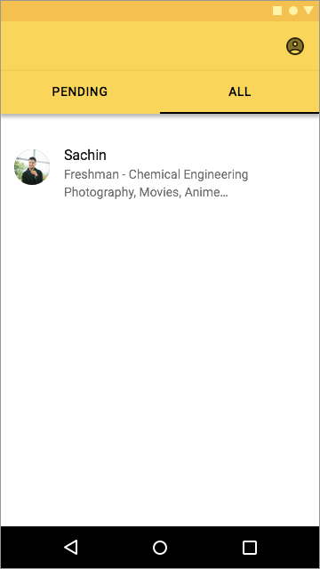
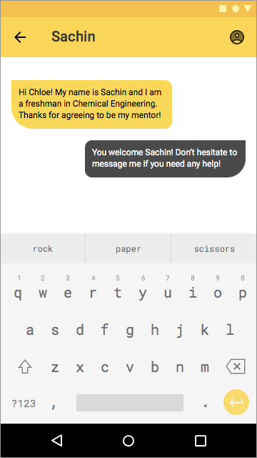
If approved, students can interact with each other through private messaging for their convenience.

Slide 38
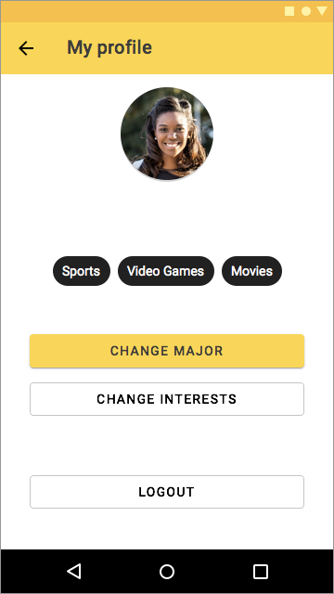
Similar to mentees, mentors can also access their profile page if they want to change their major, interests, or logout.

Slide 39
Prototype
Design
Sketches
User Flow
Wireframes
Final Design
Prototype
After the final design was done, it was time to run some quick evaluation testings to make sure the usability of the app was appropriate. Thus, I build a prototype using Principle for Mac.

Slide 40
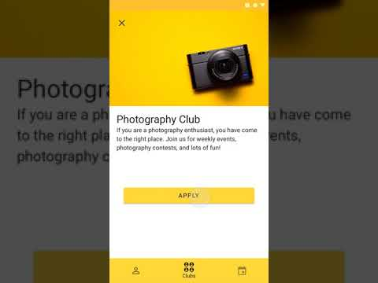
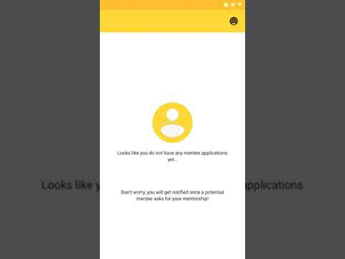
https://youtu.be/OcIYrm6FVCg
https://youtu.be/PjGH47Tg8aQ

Slide 41
Evaluation
Evaluation

Slide 42
With the prototype that I built, I ran some quick usability testing sessions with two users: one “mentee” and one “mentor”.
I gave them some task that an actual user will perform (e.g., apply to a photography club, decline a pending mentee application, and so on)
Both users were able to perform all the tasks and generally found the app to be relatively easy to use.
Evaluation

Slide 43
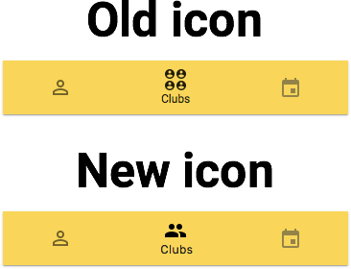
The only significant problem was that the “mentee” found the club section icon to be confusing. She suggested that the icon did not signal to her that this is a student club section. For that reason I went ahead and changed it.
Evaluation

Slide 44
The only significant problem was that the “mentee” found the club section icon to be confusing. She suggested that the icon did not signal to her that this is a student club section. For that reason I went ahead and changed it.
Evaluation

Slide 45
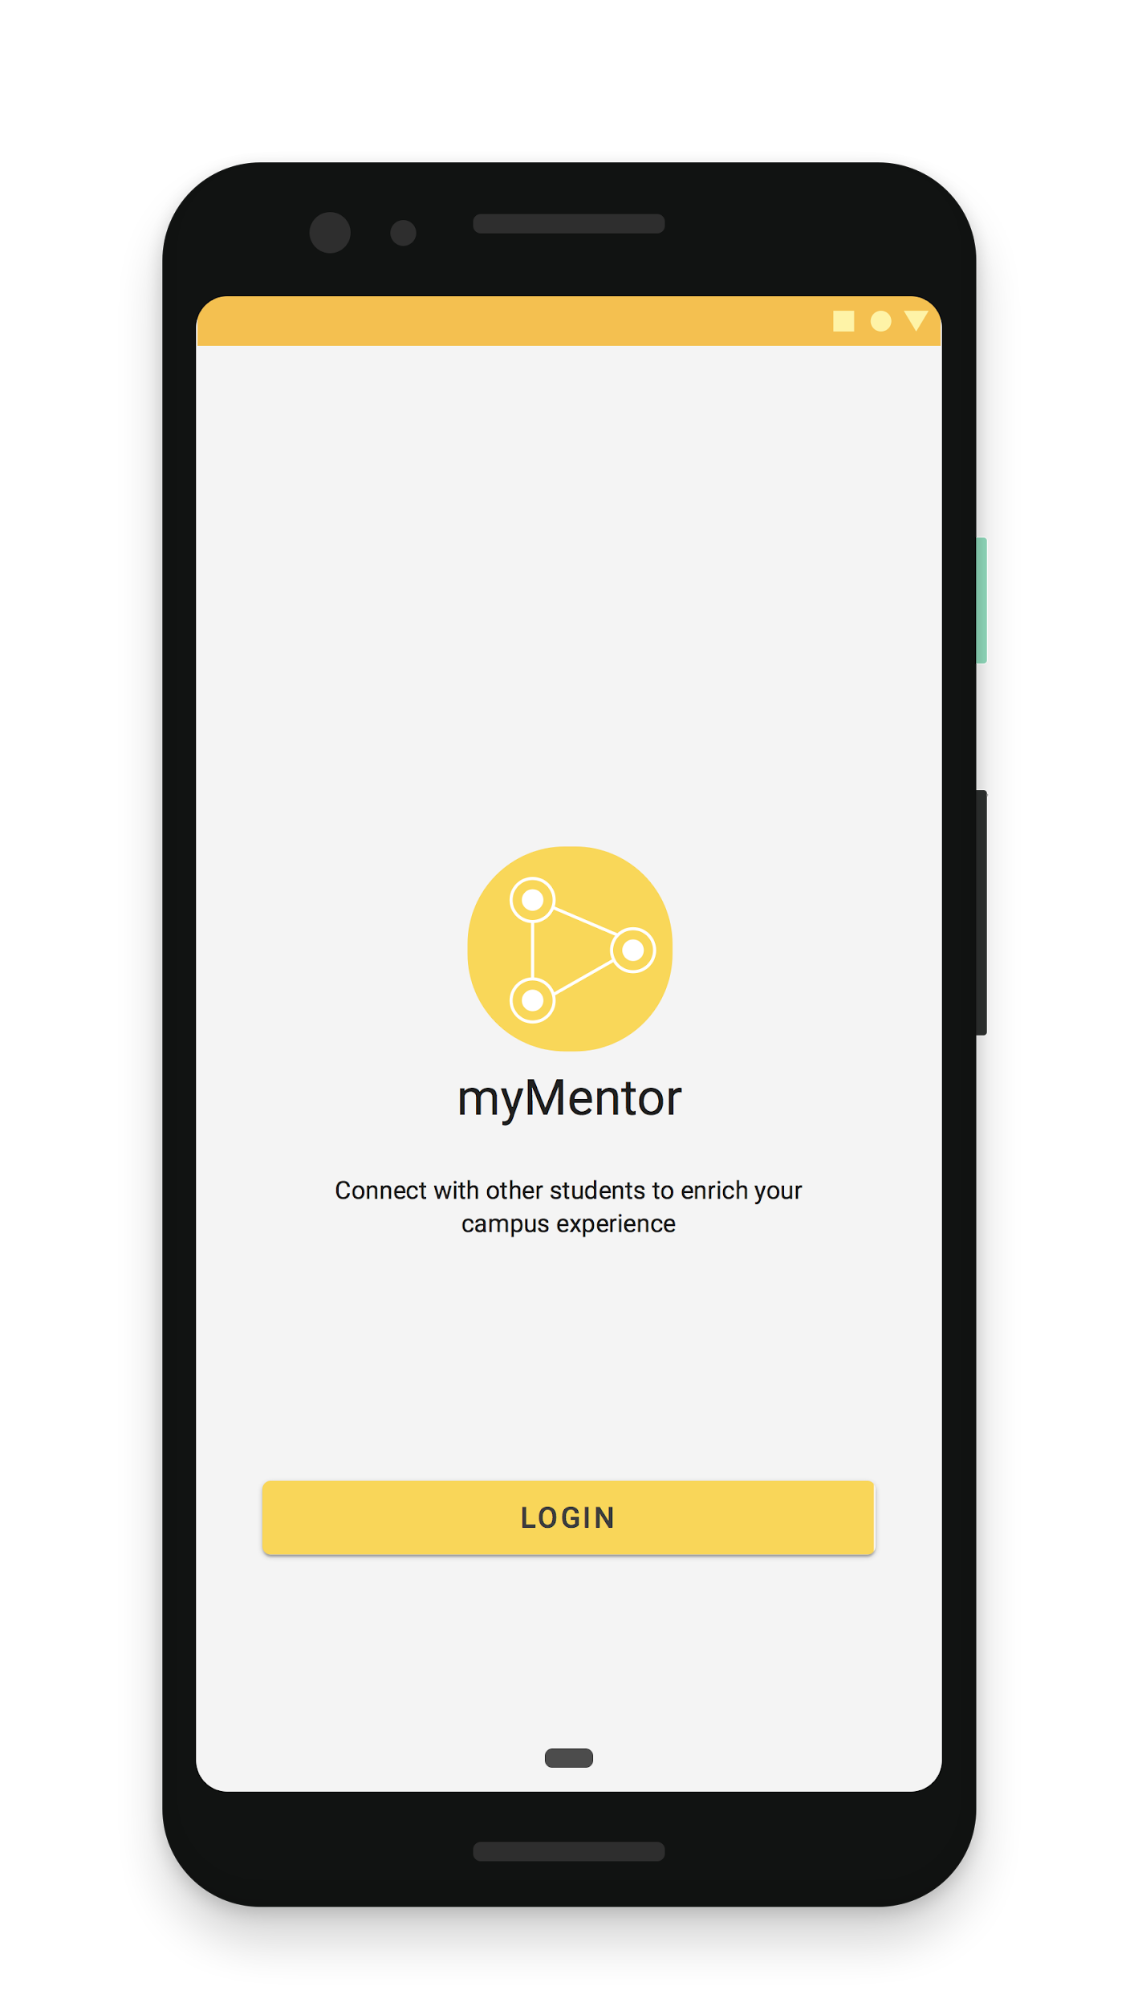
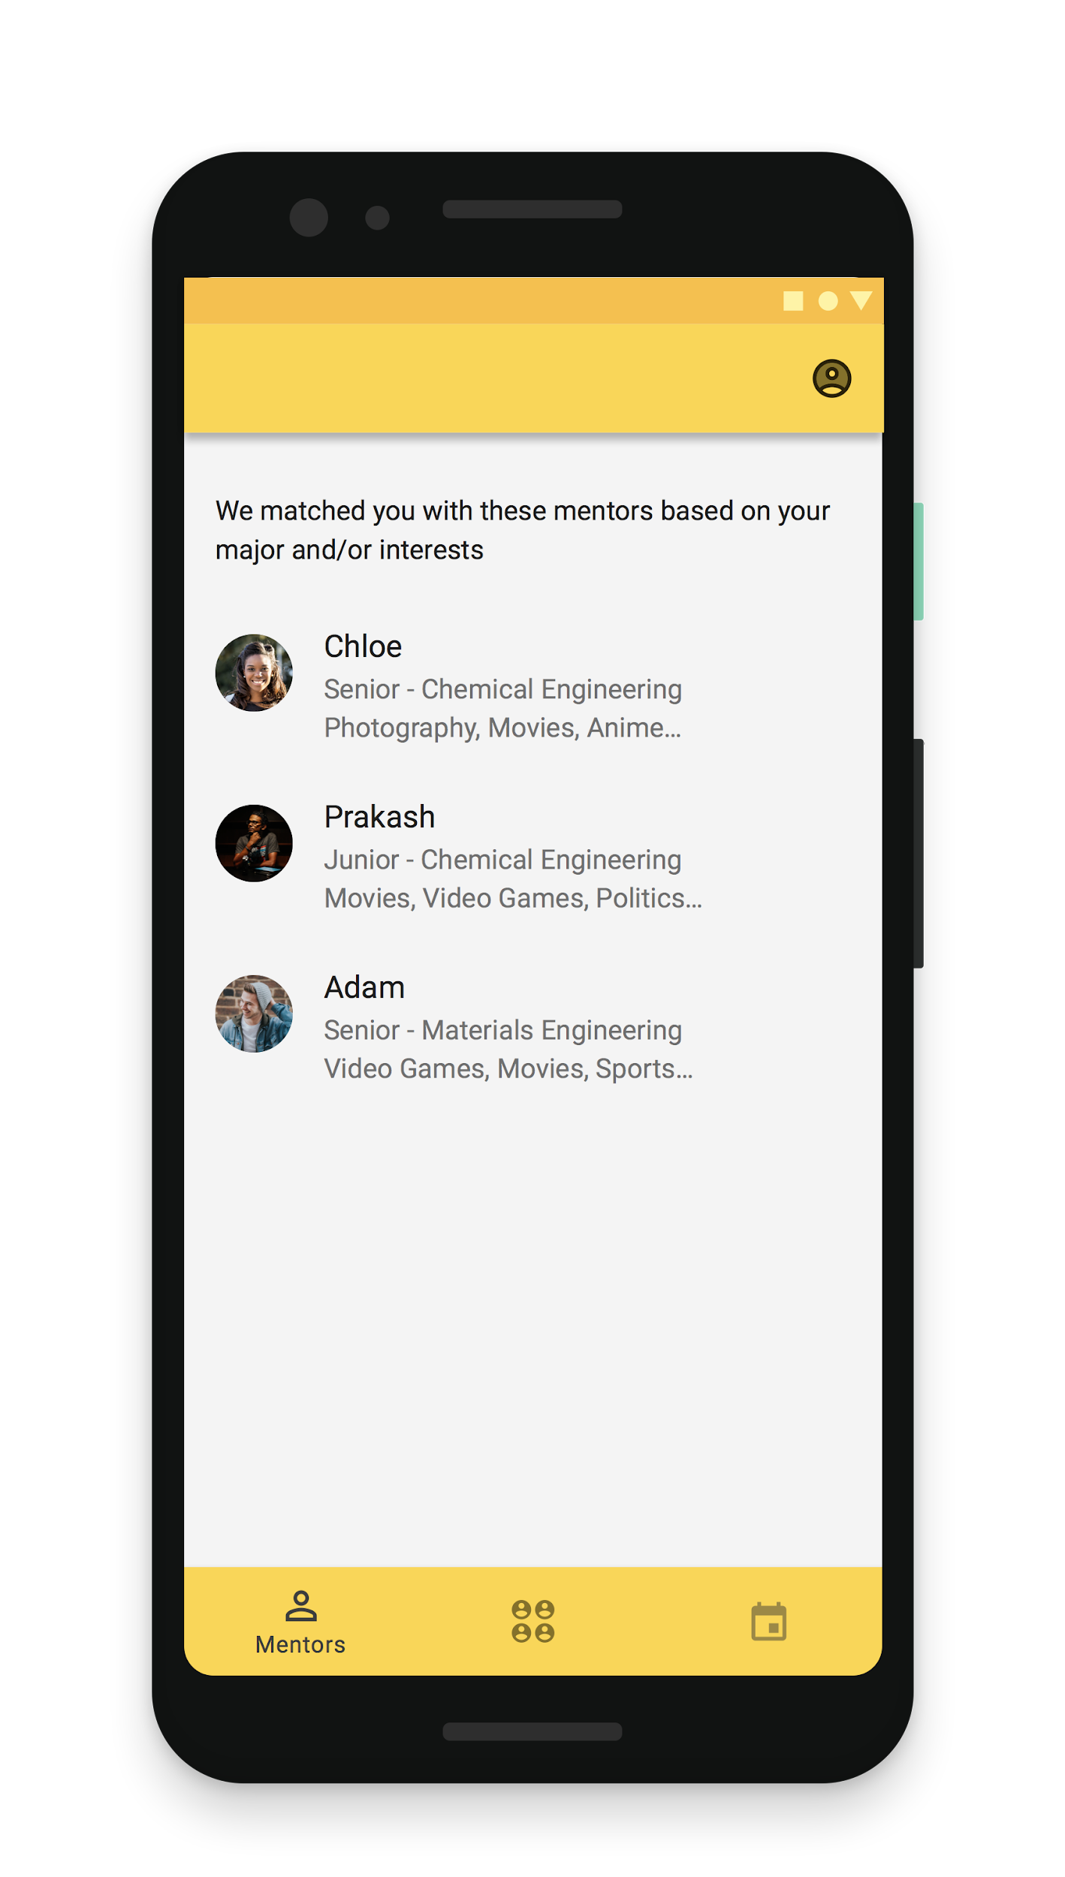
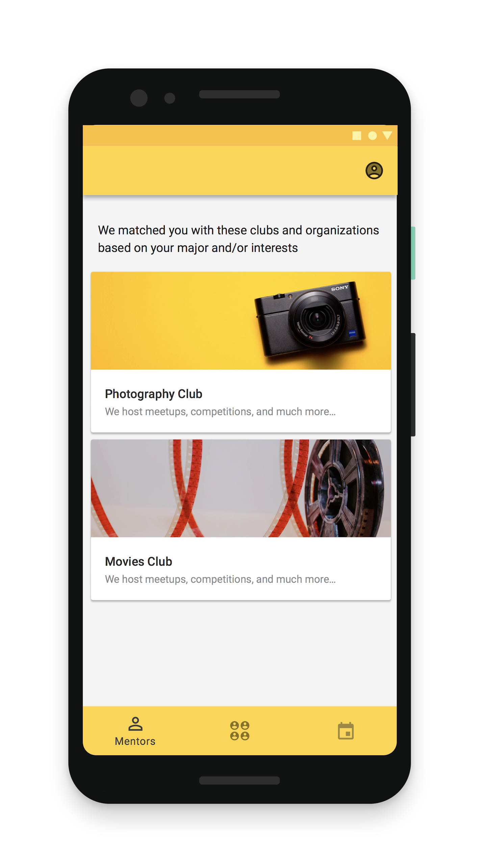
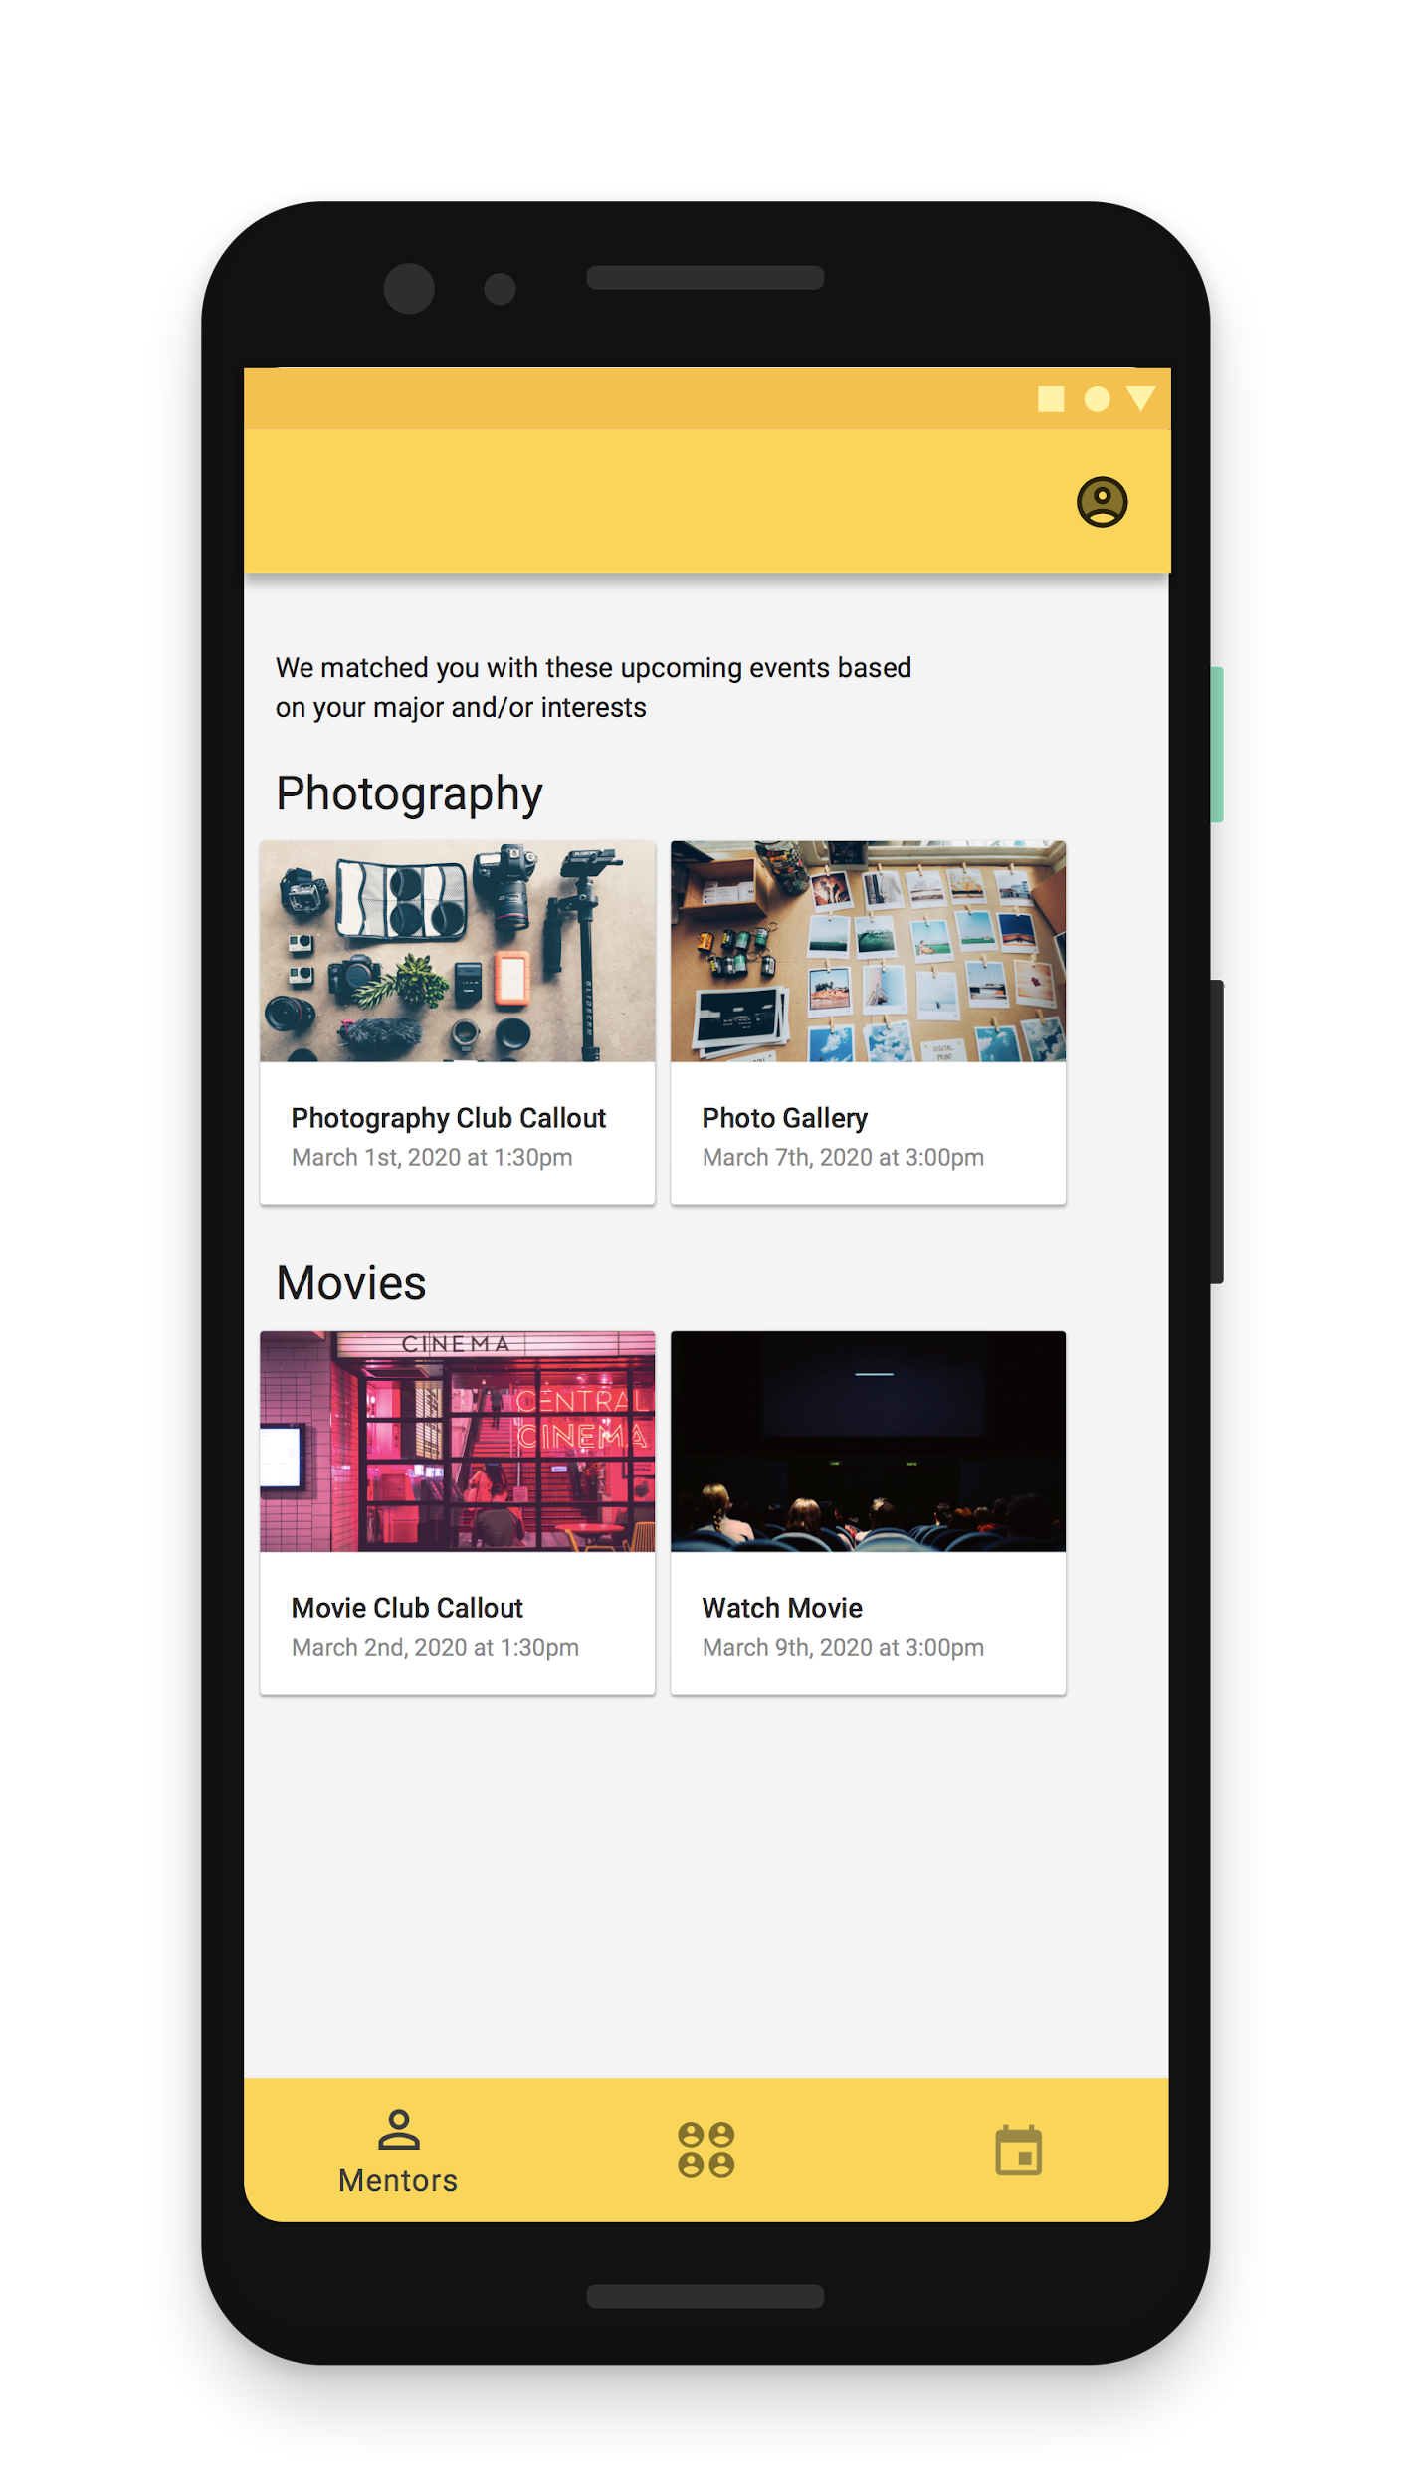

Slide 46
Thank you!

